Slide 1

An Analysis of Professional Sports Success in American Cities
ENS Douberly, ENS Lee, ENS Williams

Slide 2







Problem Definition:
Is there a city or region of the United States conducive to professional sports success?
Professional sports considered:
Main Measures of Success:
Win-Loss Percentage (W-L%)
Championships

Slide 3
Workflow Diagram:
MLB: MLB_df
1 CSV - Moving Franchise Problem
Teams per city?
Time-based experience?
NFL: NFL_df
160 XSLXs - Lack of Long-Term Database
All Sports Database:
AllSports_df
1 DataFrame with all data formatted identically and cross sports considerations incorporated
Visualization:
NBA: NBA_df
1 CSV - Variable Season Length
Packages:
Altair
Plotly
Streamlit
Panel
Choropleth
Pandas
Success Measures
NHL: NHL_df
105 XSLXs - Stripping Extraneous Data
Regions of dominance?
MLS: MLS_df
25 XSLXs - W-L% with Soccer Rules
Championships?
Pure Win-Loss?

Slide 4


Data Anomaly Examples:
NBA 2019-2020 COVID Bubble - shortened season
MLB 1994 Players Strike - no 1994 World Series
Shortened Seasons:
NFL: 1982, 2001, 2012, 2020,
MLB: 1918-19, 1972, 1981, 1985, 1990, 1994-95, 2020
NBA: 1998, 2012, 2020
NHL: 1995, 2005, 2013, 2020, 2021
MLS: 2001-02, 2020
No Championship:
NFL: —
MLB: 1904, 1994
NBA: —
NHL: 1919, 2005
MLS: —

Slide 5
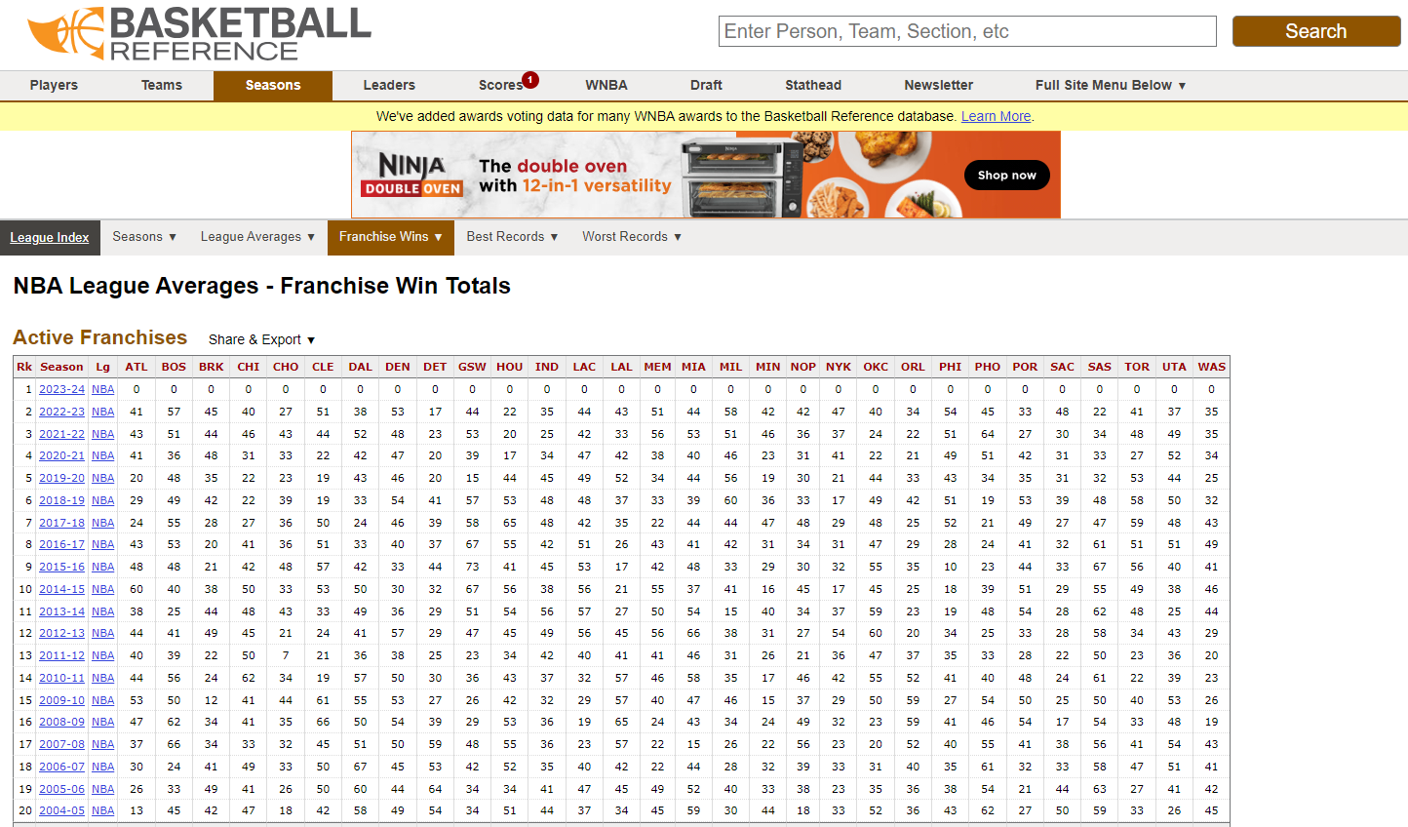
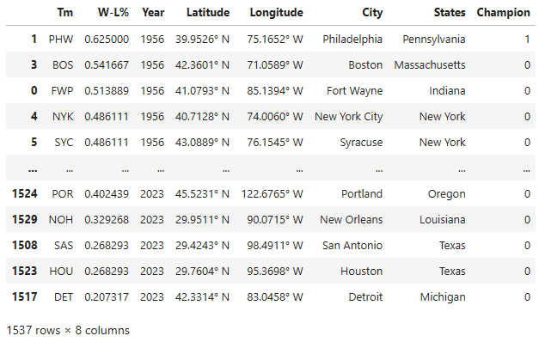
Data Collection NBA Example:
Original Source:
basketball-reference.com
1. Export as CSV and read in as df
2. Format df to match standard template of AllSports
6. Export as XLSX and concatenate to AllSports
5. Add championship data for each year
4. Add city data (lon, lat, city, state) to each team
3. Account for Data Anomalies

Slide 6
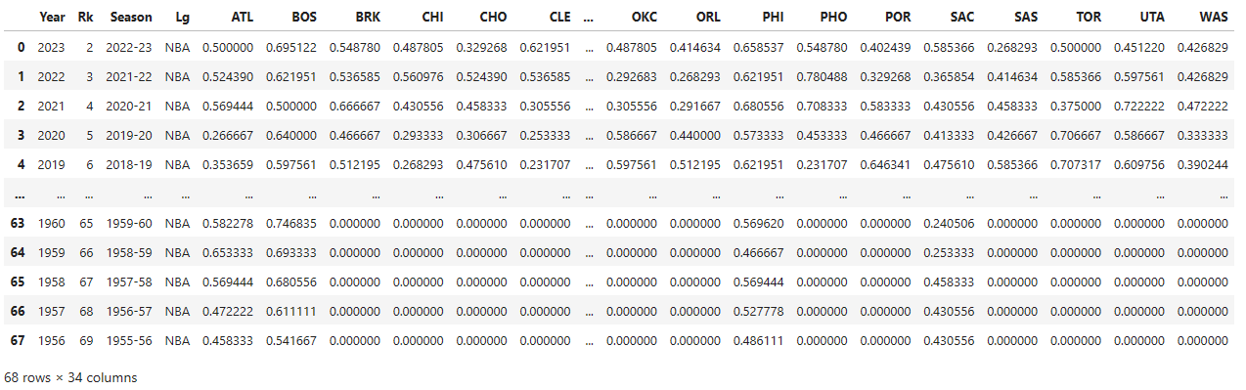
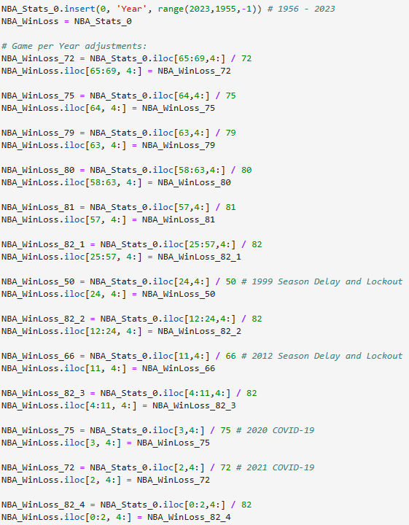
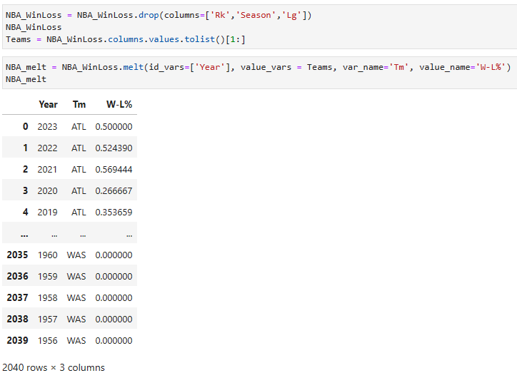
Data Collection NBA Example:

Slide 7
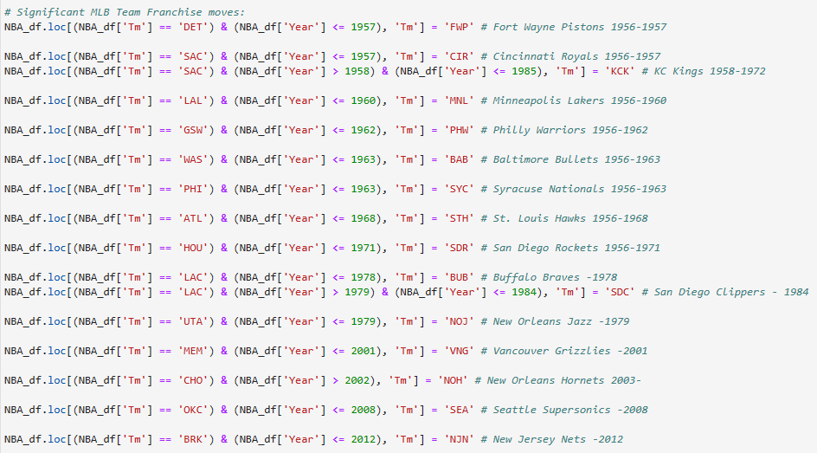
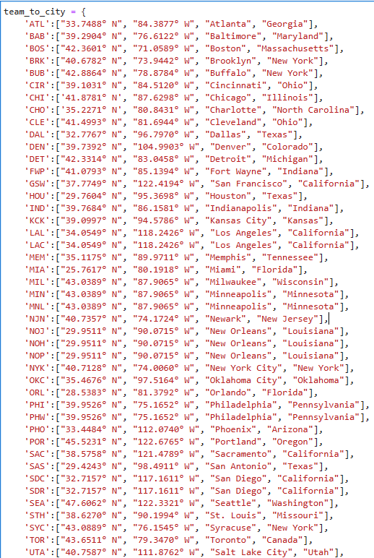
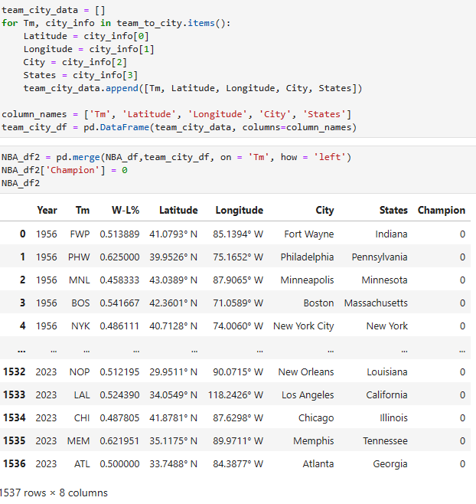
Data Collection NBA Example:

Slide 8
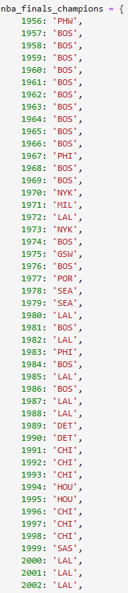
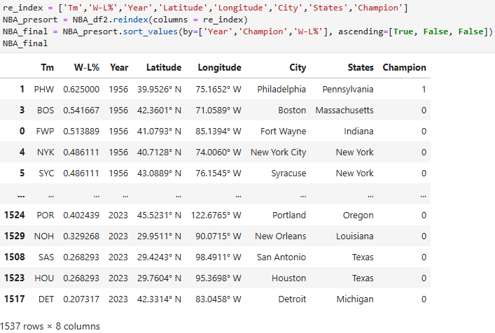
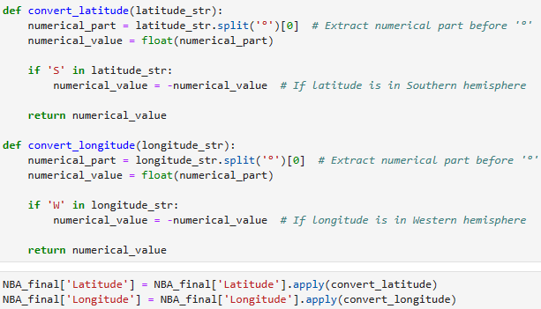
Data Collection NBA Example:
Lessons Learned:
No two datasets will be formatted identically
Assume all datasets are errored - test for validity
Work backwards from desired product with data collection for efficiency
Research is required to understand data nuisances
Uniformity across data enables cross-testing
Additional time spent in data cleaning prevents wasted time in analysis

Slide 9
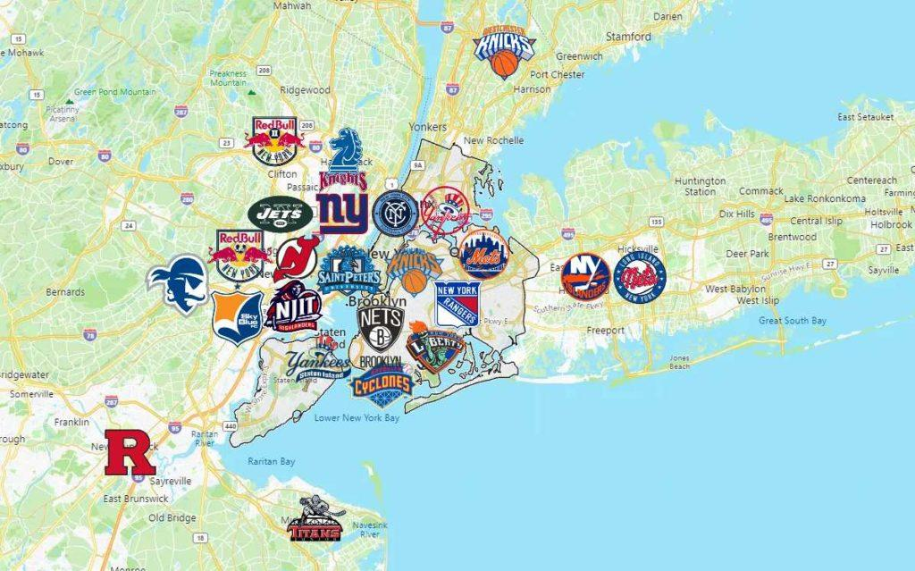
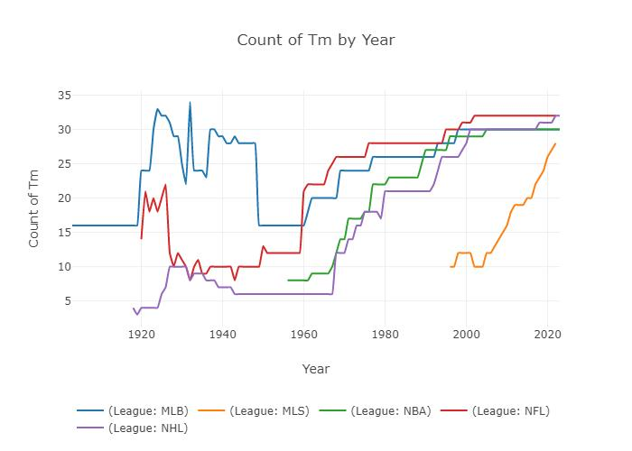

Problem Challenges:
Densely packed vs. Sparsely spread
Franchise city moves
Added teams
Differing league rules and ages
Shortened seasons
Cancelled championships

Slide 10
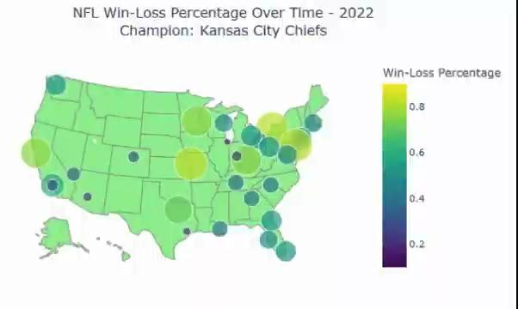
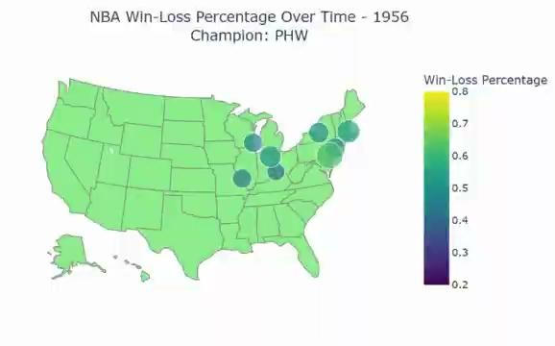
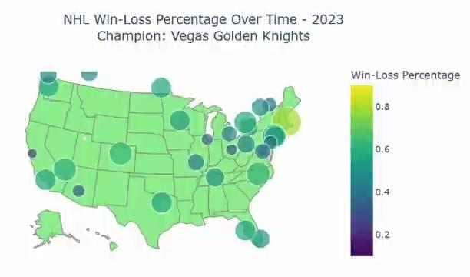
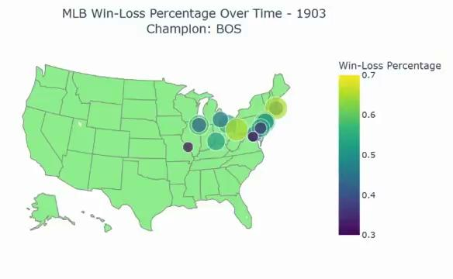
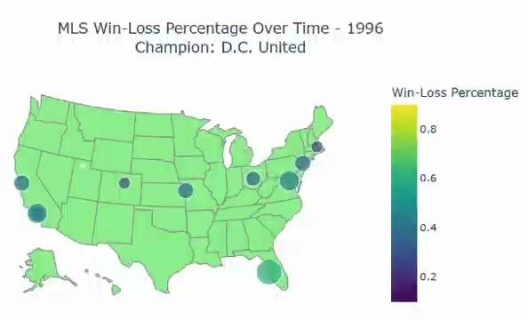
Win-Loss % over Time:

Slide 11
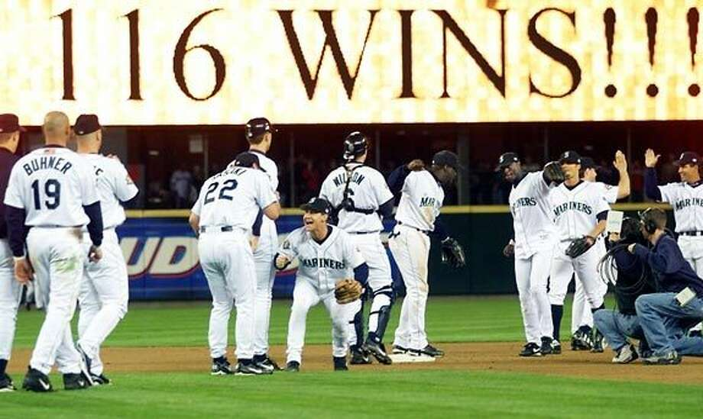
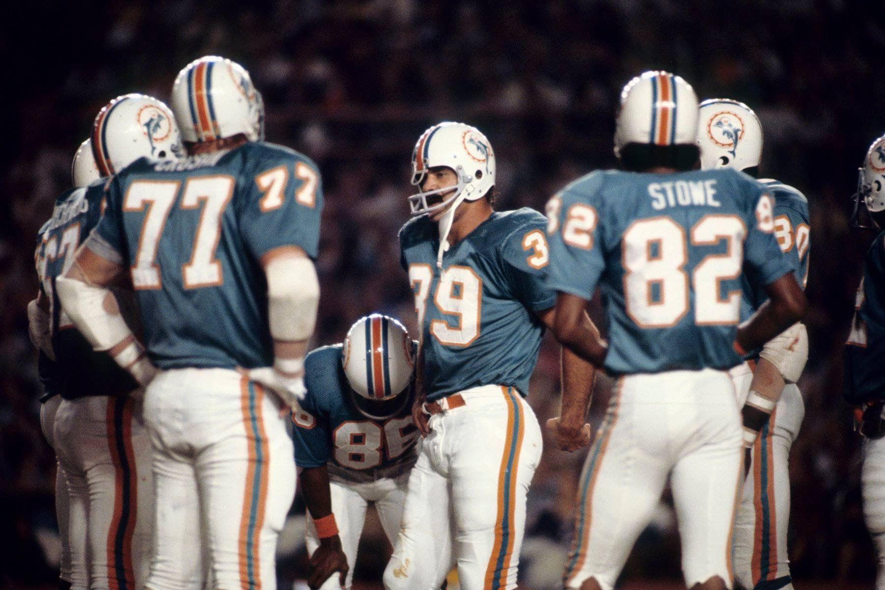

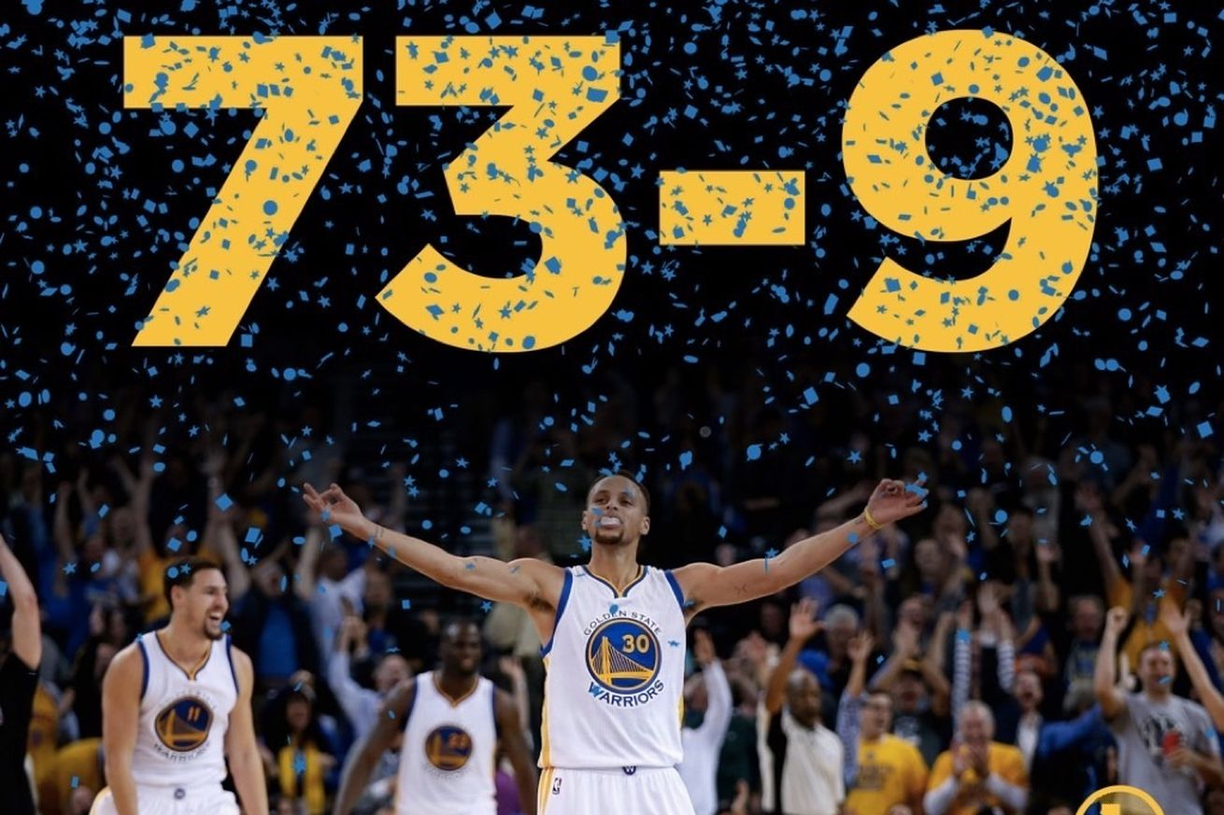
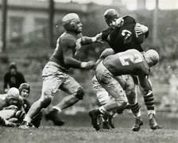

Undefeated Teams:
2001 Seattle Mariners: 116-46 (.716)
2016 Golden State Warriors: 73-9 (.89)
Only in the NFL: 16 Game regular season
2007 Patriots, 1972 Dolphins, 1942 Bears, 1934 Bears, 1929 Packers, 1922-1923 Canton Bulldogs, 1920 Akron Pros
2023 Boston Bruins: 65-12-5 (.793)

Slide 12


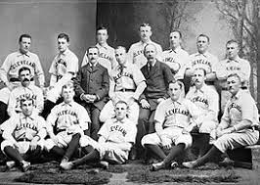


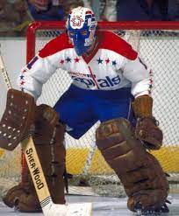
Defeated Teams:
2011 Charlotte Bobcats: 7-41 (.146)
1899 Cleveland Spiders: 20–134 (.130)
33 Teams (All NFL)
(Dis)Honorable Mentions
2017 Browns, 2008 Lions, 1976 Bucs, 1960 Cowboys
1974 Washington Capitals: 8-67 (.107)

Slide 13

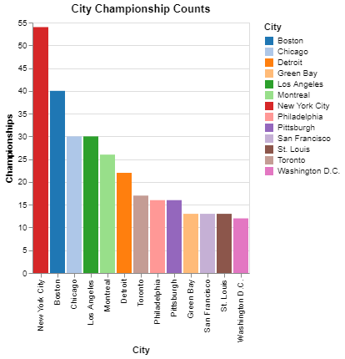



Results
Expected

Slide 14




Results
Unexpected

Slide 15
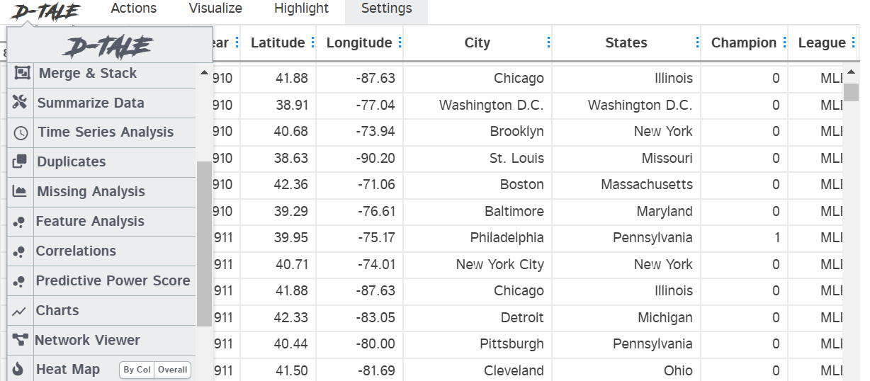
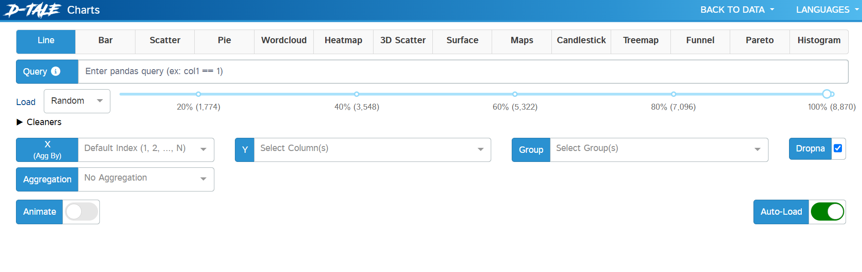



Future Work and Consideration
D-Tale Interactive Dataframes
Different Measures of Success
Rank Layering City Analyses
Weight on GDP/Team Value/Population
Isolate Decades and Analyze

Slide 16
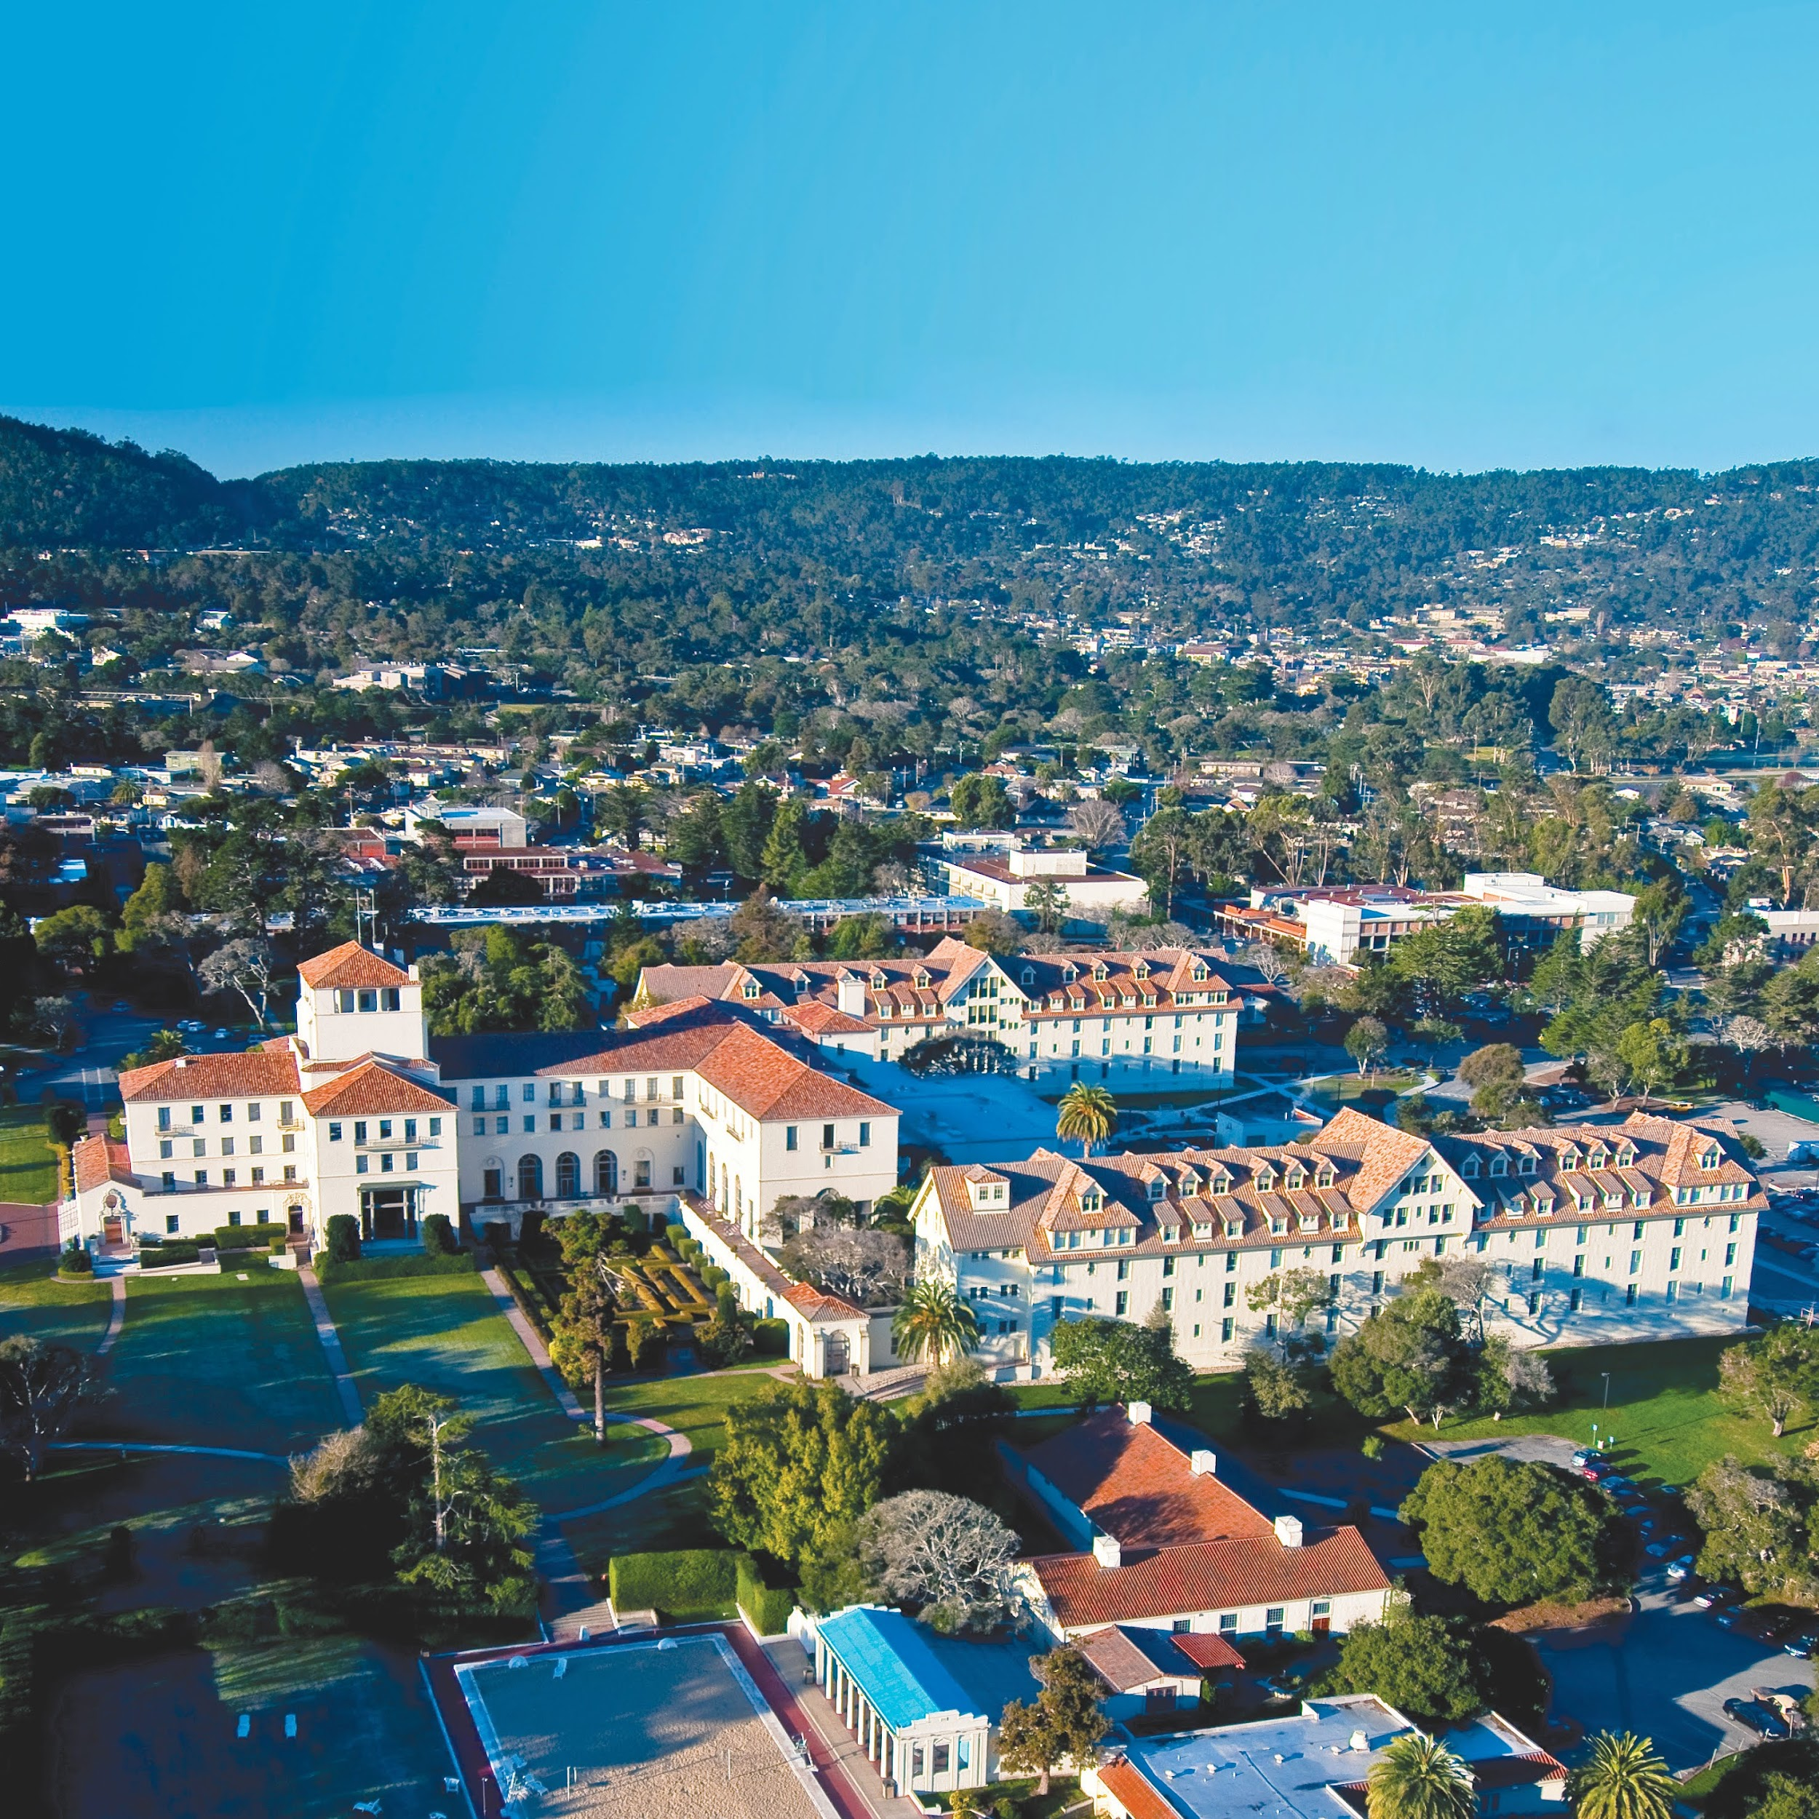
NAVAL POSTGRADUATE SCHOOL
1 University Circle • Monterey, CA 93943
(831) 656-1068 • www.nps.edu

